Slide 1




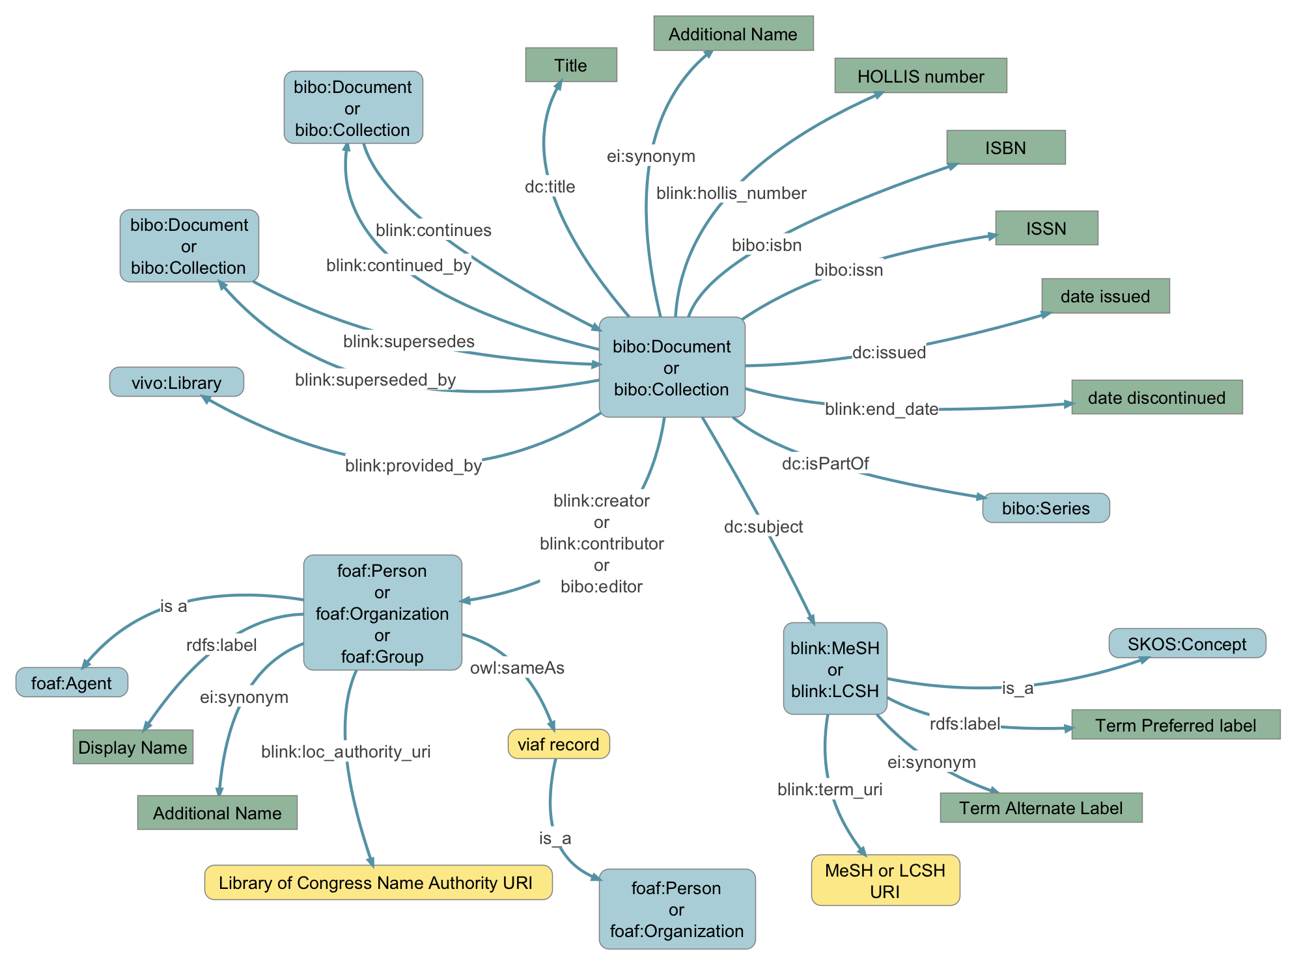

Linked Open Data for the Countway Library of Medicine
S. Cheng, P. Deschner, E. Eggleston, J. Kennedy, M. Phillips, P. Rolla,
J. Schneider and D. Bourges-Waldegg
Existing Information structure does not facilitate discovery
Standards-based information representation to leverage semantic tools
Blink facilitates discoverability and improves usefulness
Information resides in silos
Linked Open Data
RDF, for representing information:
triples, triples, triples
OWL, for expressing ontologies
SPARQL, for querying RDF
Published on the Web using URLs
Opening the silos
Twain, Mark
Clemens, Samuel L.
Clemens, Samuel Langhorne
Contes, Louis de
Medicine
Specialty, Medical
Medical Specialty
...
American Medical Association
A.M.A
AMA
Medical Association
…
Neoplasms
Tumors
Cancer
Benign Neoplasms
...
Loeb, Sophia
Loeb, Sophie Irene Simon
Simon-Loeb, Sophie Irene
...
=245 04$aThe Netherlands journal of sociology =$bSociologia Neerlandica.
=246 11$aSociologia Neerlandica
=300 \\$a13 v. ;$c24 cm.
=310 \\$aSemiannual
=362 0\$aVol. 12, no. 1 (July 1976)-v. 24, no. 2 (Oct. 1988).
Molecular Biology
Genetics, Molecular
Biochemical Genetic
Biology, Molecular
...
=100 1\$aGoodell, William,$d1829-1894.
=245 10$aLessons in gynecology /$cby William Goodell.
=260 0\$aPhiladelphia :$bD. G. Brinton,$c1879.
=650 \2$aGynecology.
=100 1\$aCretin, Shan.
=245 10$aAlternative systems for case mix classification in health care financing /$cShan Cretin, Linda G. Worthman.
=260 0\$aSanta Monica, CA :$bRand,$c[1986]
Virtual International Authority File
Medical Subject Headings
Blink Ontology
Countway
Library
=LDR 01410pam 2200385 a 4500
=001 000932210
=005 20110114185834.0
=008 860924s1986\\\\cau\\\\\\b\\\\00010\eng\\
=010 \\$a 86026053
=020 \\$a0833007637 (pbk.)
=035 0\$aocm14378520
=040 \\$aDLC$cDLC$dVET
=050 0\$aRA971.32$b.C74 1986
=082 0\$a362.1/1/0681$219
=100 1\$aCretin, Shan.
=245 10$aAlternative systems for case mix classification in health care financing /$cShan Cretin, Linda G. Worthman.
=260 0\$aSanta Monica, CA :$bRand,$c[1986]
=300 \\$aix, 73 p. ;$c23 cm.
=500 \\$a"Prepared for the Health Care Financing Administration, U.S. Department of Health and Human Services."
=500 \\$a"September 1986."
=500 \\$a"R-3457-HCFA."
=504 \\$aBibliography: p. 67-73.
=650 \0$aHospital patients$vClassification$xEvaluation.
=650 \0$aHospitals$xProspective payment.
=650 \0$aDiagnosis related groups$xEvaluation.
=650 \2$aDiagnosis-Related Groups.
=650 \2$aEconomics, Hospital$zUnited States.
=650 \2$aProspective Payment System.
=700 1\$aWorthman, Linda G.
=710 2\$aRand Corporation.
=710 1\$aUnited States.$bHealth Care Financing Administration.
=852 2\$bMED$cHD$hWX 157.3$iC924a 1986
=852 0\$bNET$cGEN
=856 41$uhttp://www.rand.org/pubs/reports/R3457.html$zFile viewed 12/06/2010
=079 2\$aocn231085200
Information is stored
as MARC
MARC format is not future-compatible
Access to related data in other silos is manual
MARC to RDF conversion using eagle-i
Next steps
Search front-end with synonym expansion
Refine MARC to RDF pipeline and leverage third party APIs
Provide SPARQL endpoint for useful RDF sources that currently don’t have one.
MARC
<dcterms:creator rdf:resource="http://blink.countway.harvard.edu/i/ 0000013a-bdc5-e2a7-12b3-349d80000000"/>
<rdf:type rdf:resource="http://purl.org/ontology/bibo/Document"/>
MARC
100 1 $$aCretin, Shan.
245 10 $$aAlternative systems for case mix classification in health care financing /$$cShan Cretin, Linda G. Worthman.
650 2 $$aDiagnosis-Related Groups
650 2 $$aEconomics, Hospital
650 2 $$aProspective Payment System
<rdfs:label>
Alternative systems for case mix classification in health care financing /
</rdfs:label>
RDF
<dcterms:subject rdf:resource="http://blink.countway.harvard.edu/i/0000013a-e1e9-a658-8b2f-b78f80000000"/>
A Harvard Library Lab Project, November 2012

